Slide 1
Mission and Evangelization in Acts of the Apostles
A Six Week Bible Study for University Students
“We will devote ourselves to prayer and the ministry of the Word” Acts 6:4
By: Sr. Clara Maria Malay, SCTJM

Slide 2
Made by Sr. Clara Maria Malay, SCTJM Servants of the Pierced Hearts of Jesus and Mary

Slide 3
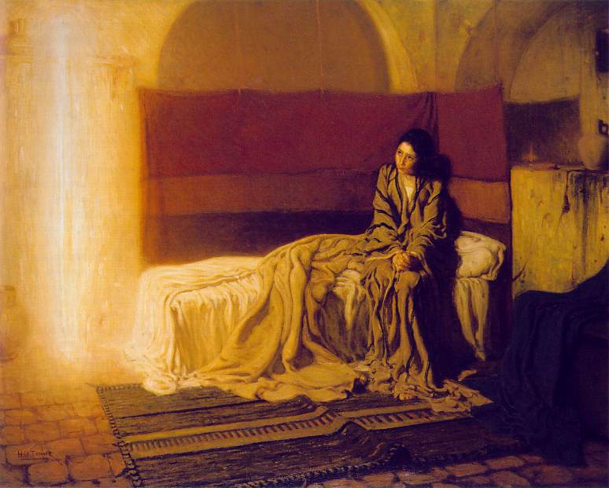
Week 1: Background and origin of Acts of the Apostles
The Acts of the Apostles is the announcement of the Church, where the apostles give their fiat.
Our Lady’s fiat is the first and serves as a model for all Christians. 1(Rogers)
The Apostles follow Our Lady in the pilgrimage of Faith, “Mary has gone before, becoming "a model of the Church in the matter of faith, charity and perfect union with Christ.”2
Notes:
1 Fr. Joseph Rogers, On Acts of the Apostles, given July 16, 2013
2 Blessed John Paul II, Redemptoris Mater, On the Blessed Virgin Mary and the Life of the Pilgrim Church, 1987, 5
b

Slide 4
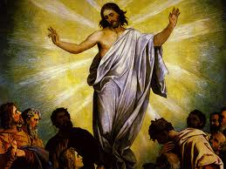
Week 1: Background and origin of Acts of the Apostles
The Historical context of Acts of the Apostles; must be understood in the context of a two volume work
Acts is the second volume work by St. Luke the first being the Gospel of Luke
Ascension both concludes Luke (24:50-51) and begins Acts of the Apostles (1:9)
Read the Gospel of Luke

Slide 5
Week 1: Background and origin of Acts of the Apostles
The plan of pilgrimage of the Church revealed in Acts 1:8, at the Ascension of Jesus
Christ’s departing statement contains four main sections that explain the role of mission and evangelization in Acts
“You will receive power when the Holy Spirit comes upon you” (found in Chapter 2 of Acts)
“You will be my witnesses in Jerusalem” (from Acts 2:3-8:3)
“Proclamation in Judea and Samaria” (from Acts 8:4-9)
“And to the ends of the earth” (from Acts 10 -28 to the conclusion)

Slide 6
Week 1: Background and origin of Acts of the Apostles
The words of Christ at the beginning of Acts give a detailed outline of the whole book of Acts
These four sections will serve as our guidepost for our Bible study.
Please use the reflection questions to go deeper into our understanding of the Lord’s words to us individually, making our faith practical.
Please keep up with the reading of the Scriptures as we travel through Acts

Slide 7
Week 2: Meaning of Mission and Evangelization in the context of Acts
The word mission derives from the Latin verb mittere, meaning; “to send”, “to let go”, and “to dispatch.” 1*
Although the concept of missions is referenced in the Old Testament and all throughout the Psalms, Jesus uses mission when He explains, how the “Father has sent Him, and He also sends us.” (Jn 20:21)
Therefore all of us are sent, not limited to a few but all members of the Mystical Body of Christ must share will all Humanity. Missionary Mandate Mt 28: 19-21
Jesus is on mission from the Father and so He sends us on mission . . .to continue his work of redemption
Notes:
*1 Anaeto, Dominic, Fr, PS 514, Mission and Evangelization, class notes, Lesson 1, Week 1, Definition of Mission.

Slide 8
Week 2: Meaning of Mission and Evangelization in the context of Acts
Evangelization is the sharing of the Good news of the Gospel to have an encounter with Christ and bring about a conversion
The main goal is to lead others to the faith, freedom and peace of Christ by grace and the sacraments.
Mission and evangelization encourage one another. The mission is to bring people in to relationship with Christ and it is achieved through evangelization.
A Missionary is sent to share the Good news and evangelize as Mary and the Apostles were in the Acts of the Apostles.

Slide 9
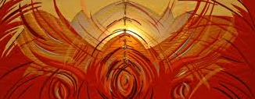
Week 2: Meaning of Mission and Evangelization in the context of Acts
Reflection Questions
Do I recognize my call to missions as a member of the Body of Christ?
How have I been evangelized in the faith?
How am I sharing the Good News of the Gospel with others?
Do I thank God for the Boldness of the Apostles, realizing that I have the gift of faith because of them. Do I pray for God to give me that same boldness?

Slide 10
Week 3: “You will receive power when the Holy Spirit comes upon you” Acts 2
The Acts of the Apostles has been called the Acts of St. Paul, the Acts of St Peter, or the Holy Spirit!
All these are true statements although the mission of the Holy Spirit is what is driving St. Paul, St Peter, and all the apostles to leave their homes and go on mission to evangelize.
“Acts is not a history of the early Church which many people think, but rather, shows the power of the gospel and how it transformed the Roman Empire with the preaching of the apostles.”*
Notes:
* Fr. William Mills, SS 905, Book of Acts, Class notes week one, given August 26, 2013

Slide 11
Week 3: “You will receive power when the Holy Spirit comes upon you” Acts 2
The main purpose of Acts is to tell and show the spreading of the gospel to the nations.
St. Luke emphasizes the “Word of God” spread and grew and increased as the apostles kept preaching the good news.
For it is the gospel which gives life and only through the power of the Holy Spirit
Before the power of the Holy Spirit came upon them they were scared in the upper room not willing to leave.
Notes:
*Cf: Fr. William Mills, SS 905, Book of Acts, Class notes week one, given August 26, 2013

Slide 12
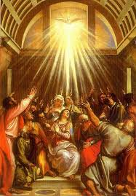
Week 3: “You will receive power when the Holy Spirit comes upon you” Acts 2
Reflection Questions
Am I afraid to share my faith with others?
Have I prayed for the Power of the Holy Spirit to come upon me?
Do I seek the Lord’s strength or do I rely too much on my own will, plans and abilities?
What is keeping me from leaving the upper room of my heart?
Read Acts chapter 1-2

Slide 13
Week 4: “You will be my witnesses in Jerusalem” Acts 2:3-8:3
Witness is derived from the Greek word ‘martyria’, translating as martyr
A witness or martyr is “someone who stands firm, giving testimony to one’s faith, even in the face of suffering or death.”*
Chapter 6 records the martyrdom of St. Stephen, known as the first martyr while St. John the Baptist was killed earlier for his faith.
St. Stephen was one of the seven deacons chosen and anointed to help with the ministry, to be witnesses
Notes:
*Fr. Peter Stravomslas, Ph. D.. S.T.L., Our Sunday Visitor’s Catholic Encyclopedia, Our Sunday Visitor Publishing Division, Huntington Indiana,(1991) 628

Slide 14
Week 4: “You will be my witnesses in Jerusalem” Acts 2:3-8:3
“The witness of a Christian life is the first and irreplaceable form of mission.”*
Our mission begins with the witness of our lives.
Notes:
*Pope John Paul II, On the Permanent Validity of the Church’s Missionary Mandate, Redemptoris Missio, (1990), 42

Slide 15
Week 4: “You will be my witnesses in Jerusalem” Acts 2:3-8:3
Reflection Questions
Do I live an authentically Christian life, to give witness to Christ to all that I meet?
How have I responded to Christ command to be His witness?
Am I willing to give testimony to my faith even when it may include suffering or death?
Read Acts 2:3-8:3, discuss the specific details of Stephen’s death and the death of Christ.

Slide 16
Week 5: “Proclamation in Judea and Samaria” Acts 8:4-9
While sharing the faith the Apostles meet Simon the magician, who desired the power of God for his own gain.
His heart was not in the correct place and his intention was for himself instead of God.
Missionaries are constantly challenged keep the focus on Christ and not on self.

Slide 17
Week 5: “Proclamation in Judea and Samaria” Acts 8:4-9
“The missionary is required to "renounce himself and everything that up to this point he considered as his own, and to make himself everything to everyone." This he does by a poverty which sets him free for the Gospel, overcoming attachment to the people and things about him, so that he may become a brother to those to whom he is sent and thus bring them Christ the Savior. This is the goal of missionary spirituality: "To the weak I became weak...; I have become all things to all men, that I might by all means save some. I do it all for the sake of the Gospel..." (1 Cor 9:22-23).”*
Notes:
*Blessed John Paul II, On the Permanent Validity of the Church’s Missionary Mandate, Redemptoris Missio, (1990), 88

Slide 18
Week 5: “Proclamation in Judea and Samaria” Acts 8:4-9
Paul’s conversion is mentioned three times in Acts and each include different details. The first time in chapter 9
The variations may be due to the audience he was sharing with or what he was trying to convey.
While it is true that his conversion is a triumph of Love and is very telling of God’s great love for all and desire for repentance
His conversion highlights
the great merciful love that the Father has for each of us no matter how far we have strayed.
the need for continual conversion, ongoing until death
the power of God’s call on our lives reflecting on what and how we respond to Christ who is calling us
St. Paul’s conversion paves the way for his great missionary activity in the Church

Slide 19
Week 5: “Proclamation in Judea and Samaria” Acts 8:4-9
Reflection Questions
Do I proclaim the Gospel, using words and not only witness?
What are my intentions when I am sharing the good news?
Do I look for opportunities to share what God has done in my life?
Do I seek continual conversion in my person life?
Does my conversion process lead to or encourage my missionary efforts
Read Acts 8:4-9

Slide 20
Week 6: “To the Ends of the Earth” Acts 10-28
The Apostles were unsure if the Lord really intended to include all peoples and nations in the proclamation of the Faith. There was much more separation between nations and religions among humanity than there is now.
When faithful individuals from other nationalities came to St. Phillip and St. Peter and the Holy Spirit fell on them. This was a confirmation of the Lord’s words that later St. Peter declared at the first Council in Jerusalem
“There rests, by divine mandate, the duty of going out into the whole world and preaching the gospel to every creature.’ And in another text: ‘...the whole Church is missionary, and the work of evangelization is a basic duty of the People of God.”*
Notes:
*Pope Paul VI, Evangelii Nuntiandi, On the Evangelization of the Modern World, (1975) 59

Slide 21
Week 6: “To the Ends of the Earth” Acts 10-28
Both the Ethiopian Eunuch and the Centurion represent world powers and major nations
Taking the faith of the Israelites to the “Gentile Nations”*
Jesus was showing the apostles that he really meant to the ends of the Earth
Notes:
Image taken from Golden Valley Lutheran Church at gvlc.net
*Cf: Fr. William Mills, SS 905, Book of Acts, Class notes week five, given August 26, 2013

Slide 22
Week 6: “To the Ends of the Earth” Acts 10-28
Reflection Questions?
Do I question God’s commands or do I seek to obey even in my misunderstanding?
How did Peter respond to Cornelius a Roman?
Do I treat those who are different from me with the same respect?
Am I reaching out beyond my surroundings to share the good news to the ends of the Earth?
Read Acts 10-28

Slide 23
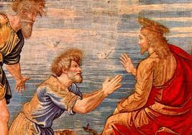
In Conclusion
The Book of Acts of the Apostles could be considered the Acts of Peter or Paul but most especially of the Holy Spirit. It is the ground work of the Church and continues to serve as a plan of mission for each of Her members. May we faithfully adhere to the teachings of Scripture and continue the redeeming mission of Christ through the power of the Holy Spirit.

