Slide 1
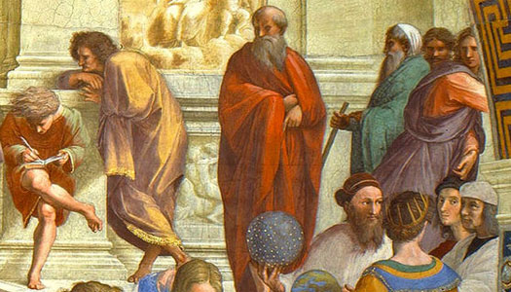
NEO-PLATONISM AND THE EFFECTS ON THE THOUGHTS OF ST. AUGUSTINE
Sister Lucia Maria, sctjm
Holy Apostles College and Seminary
PHL. 301 History of Ancient Philosophy
Fall 2013

Slide 2
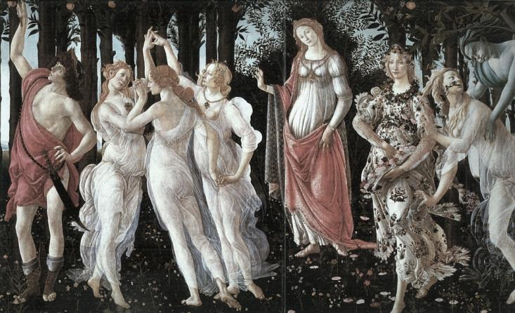
What is Neo-Platonism?
-St. Augustine’s thought and philosophical theology of original sin, free will, and the nature of man was greatly influenced by Neo-Platonism; which is a variety of Platonism founded by Plotinus (AD 205-270), the philosophical foundation of the theology of Marius Victorious, Ambrose, Augustine and Boethius. It focuses on the humans soul’s fall into matter and its redemption; through its conversion to reason, the soul proceeds upward from the material world to God.
Picture taken from: http://cristhiantellez.files.wordpress.com/2009/05/botticelliprimavera.jpg

Slide 3
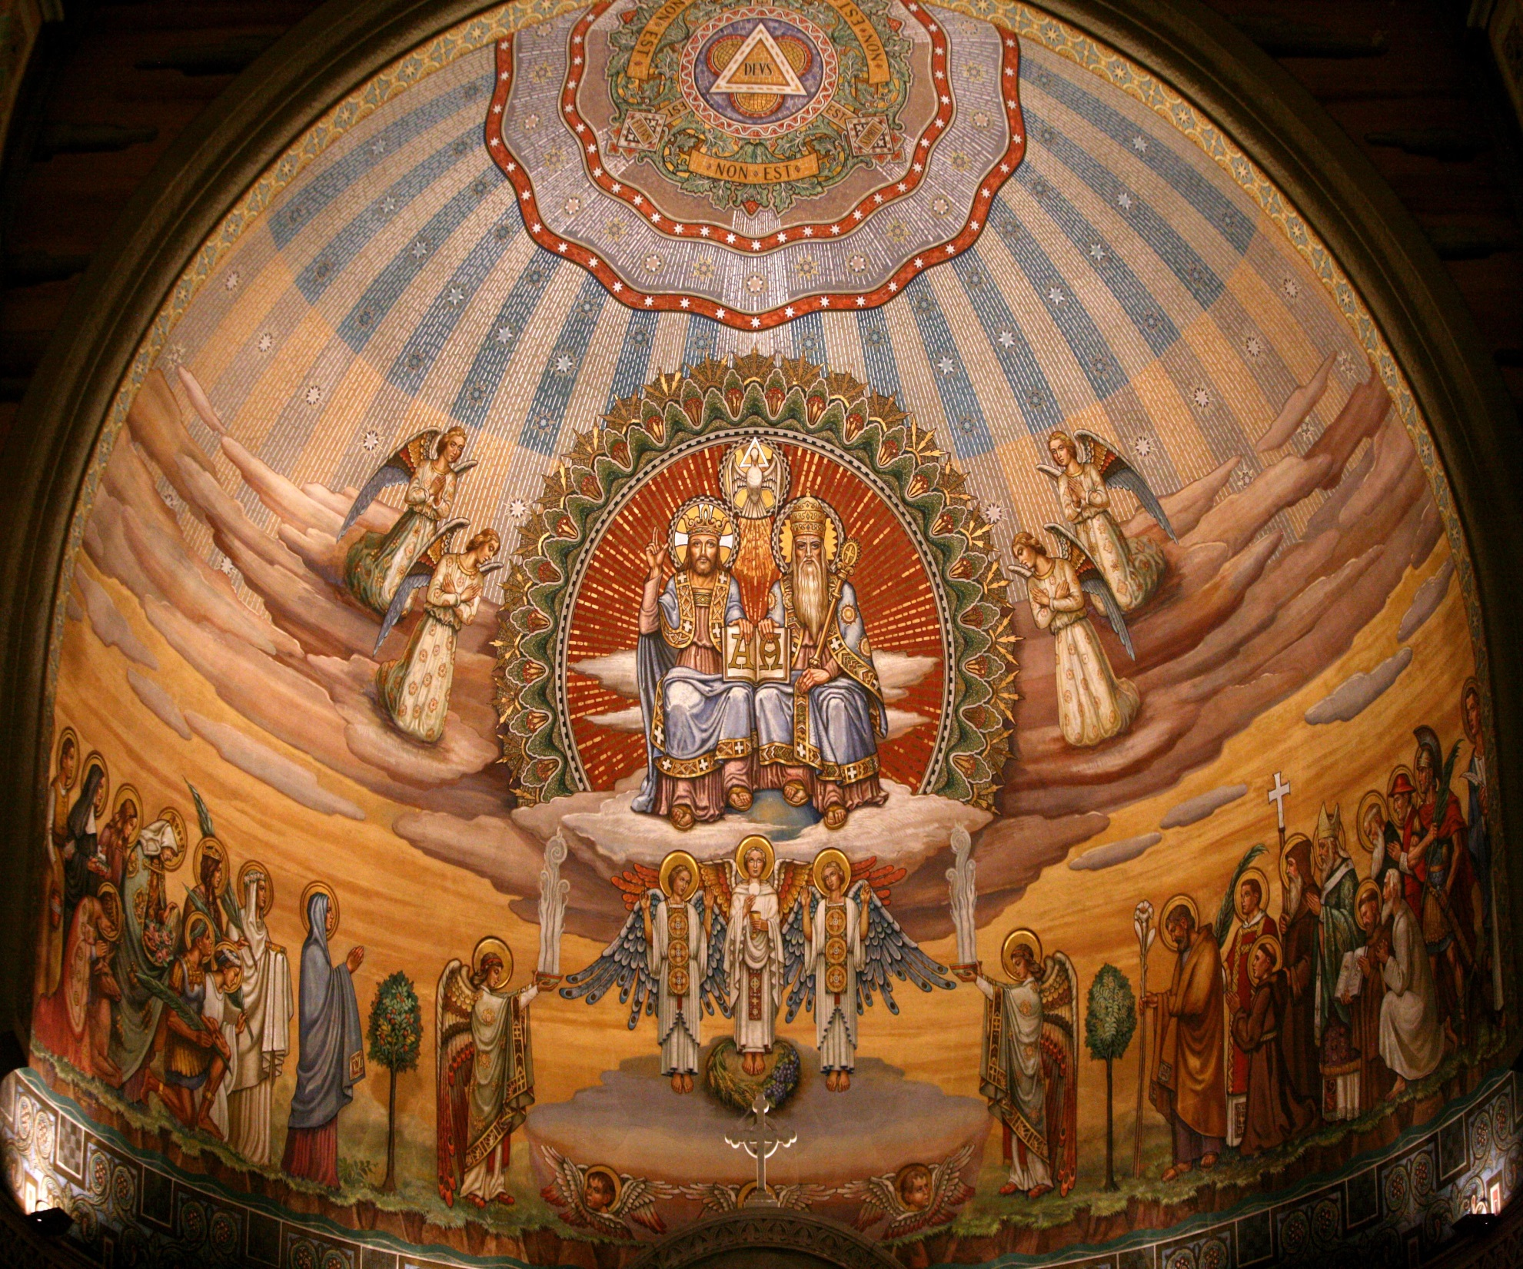
St. Augustine’s view of the Church and Neo-Platonism
To the Church he looked as to an authority which he could always obey, and he accepted the mysteries of the Incarnation and the Trinity. (Against the Academics, 22.)
To Neo-Platonism he looked for the rational explanation of everything. He wished not merely to believe, but to understand. (Against the Academics, 22.)
- St. Augustine was persuaded and this was precisely the nerve of the whole matter. That as God was the source of both the way of reason and the way of authority there could be no possible conflict between these two ways. (ibid.)
The Church = Authority
Neo-Platonism = Reason
Picture taken from: http://blog.cleveland.com/metro/2009/09/holy-trinity-church-fresco.jpg

Slide 4
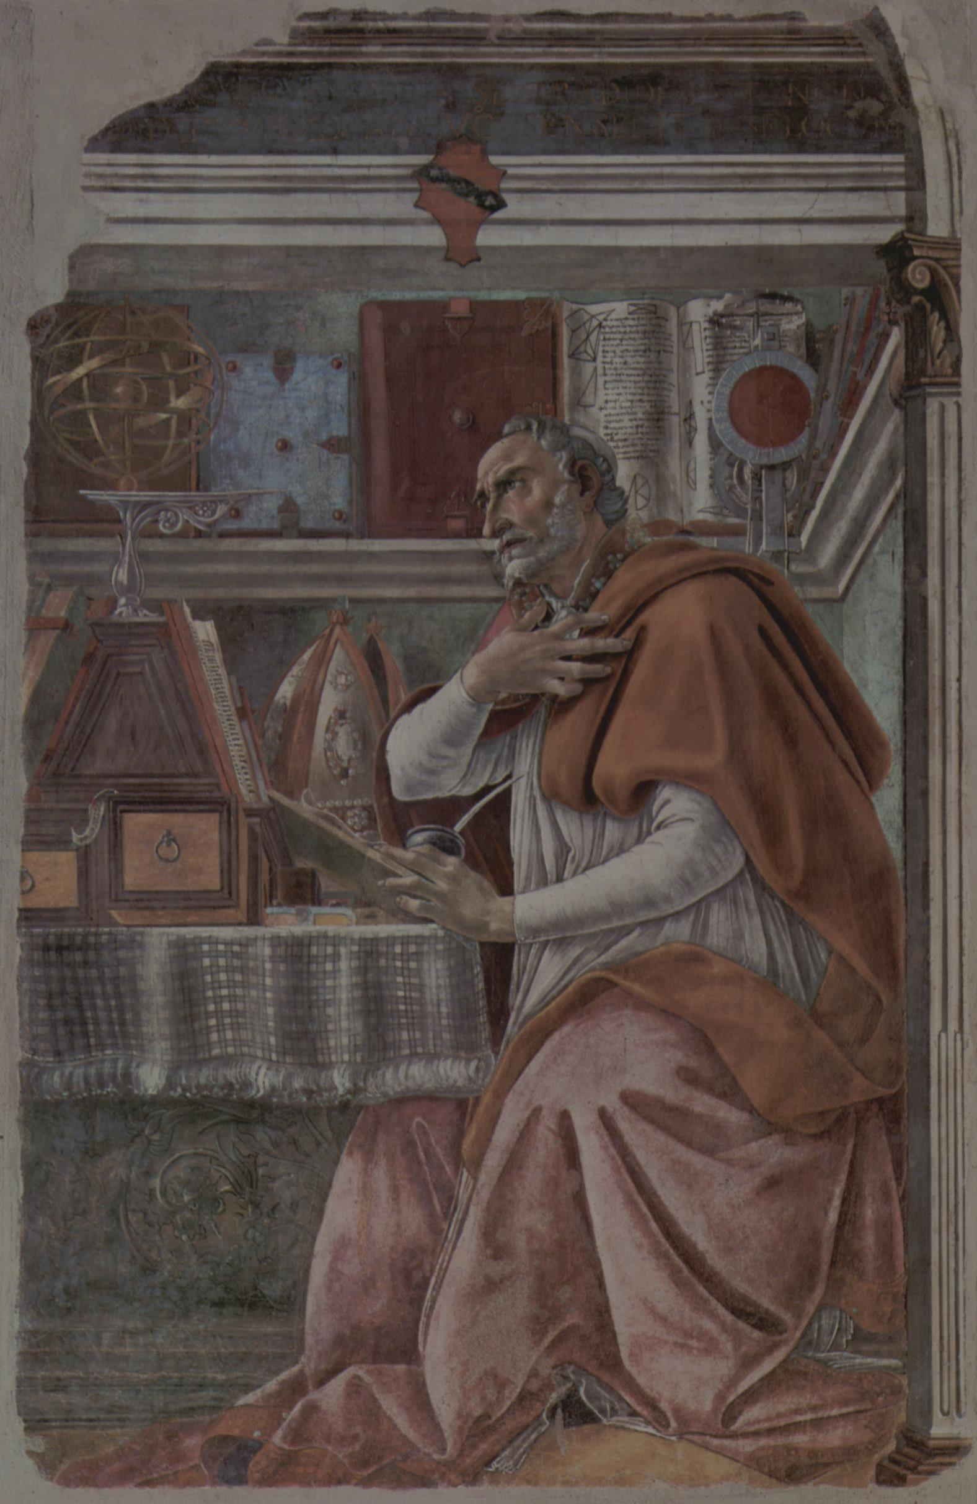
St. Augustine of Hippo (AD 354-430)
He belonged to the circle of St. Ambrose, since he was impelled by the great Milanese Bishop’s apostolic zeal and persuasive preaching to search both his mind and soul to amend his life. He ardently desired to win over to the ideals of Christian faith the Roman world, peopled by so many pagan intellectuals who were intensely proud of their education and culture.
Augustine was most appealing, writing as he did during the last triumphs of Rome’s imperial power but also during the initial stages of its collapse. His powerful rhetorically vivid description of the saga of humanity dominated western theology from the medieval period forward.
Picture taken from:http://upload.wikimedia.org/wikipedia/commons/a/ac/Saint_Augustine_Portrait.jpg

Slide 5
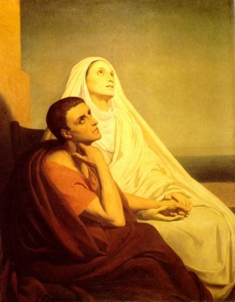
Neo-Platonism in the life of
St. Augustine
According to his own account, Augustine’s pursuit of the philosophic life began when he came across and read Cicero’s Hortensius during his regular course of studies at Carthage. (Conf. 3.4.7) He was nineteen at that time, and had risen to the top of his class. He showed great promise, but he was also deeply dissatisfied with his studies and restless at heart. Could be that this strange combination of excellence and emptiness that motivated him to pursue the subject of the Hortensius; But, it is clear that wisdom captured his heart.
Initially, he was taken by St. Ambrose rhetorical style and then became intrigued by his philosophical notions (Neo-Platonism) and the way he read or interpreted Sacred Scripture. The doctrines of Ambrose coupled with his own personal reflections moved Augustine a long way towards his most dramatic conversion back to Catholicism. Platonism played a major role in Augustine’s conversion.
Picture taken from: http://3.bp.blogspot.com/-CeJ95DBW4pI/Uh5H4p878DI/AAAAAAAAAgE/5q-y0UF52lU/s1600/Saint_Augustine_and_Saint_Monica.jpg

Slide 6
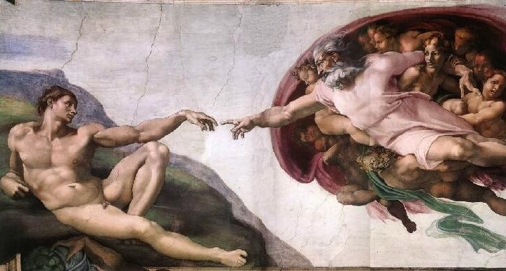
For a long time he had many thoughts going over his mind, he desired three things: to know himself, his chief good and what evil was to be shunned.
“The Neo-Platonists taught Augustine in Milan the metaphysical truths about God, namely that he is immutable, immaterial, highest unity, and highest good.” (Johannes Brachtendorf, "Orthodoxy without Augustine," Ars Disputandi 6 (2006).
The “Platonic books” helped him resolve two difficult issues which were:
- The Nature of God
- The Problem of Evil
“Augustine indubitably wanted to make a connection between Platonism and Christianity because he knew that besides the flesh and the internal debates within the Catholic Church the wisdom of the world was the most powerful & compelling force to fight against. He was perhaps divinely positioned through those years of rigorous intellectual preparation and internal struggles, ranging from concupiscence to intellectual doubt to cultic following, to discover that he could use their own terms & concepts against them.” (Livermore, Jeremy. "Augustine’s Philosophical Theology & Neoplatonism." Web log post. Apologetics.com. N.p., 12 Dec. 2009. Web. 10 Nov. 2013.)
Picture taken from: http://2.bp.blogspot.com/kAuyf8bu394/UHXpLqhTCNI/AAAAAAAAHSo/_h0tLlbNWr0/s1600/10.10-c.png

Slide 7
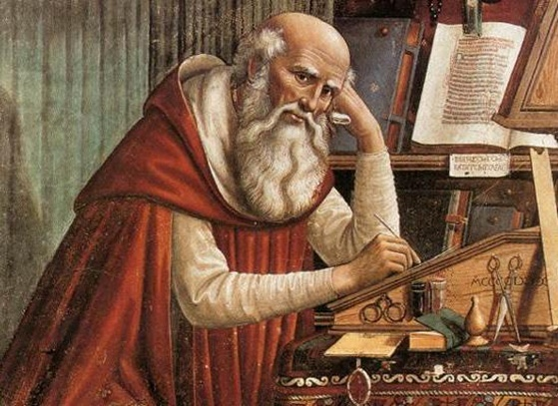
Christianity
In regard to the former he discovered truth as the intelligible, objective and immaterial light of the soul, and to the latter he discovered evil to be not exactly a thing but privation (absence due to nature) of good. It was, however in Christianity most especially in the writings of St. Paul and St John - that St. Augustine discovered the more sublime notions of mediation, participation and grace which helped to overcome his “naturalism”.
Among the greatest works of St. Augustine are:
“The City of God”
“Confessions”
“Against the Academics”
(In which we can appreciate the different relations there was between Platonism and Neo-Platonism in St. Augustine’s thoughts throughout his life ever since before and after his conversion to Catholicism.)
Picture taken from:http://www.reasons.org/Media/Default/ImageCache/559x400-FitWidth/Images/st-augustine-2-1.jpg

Slide 8
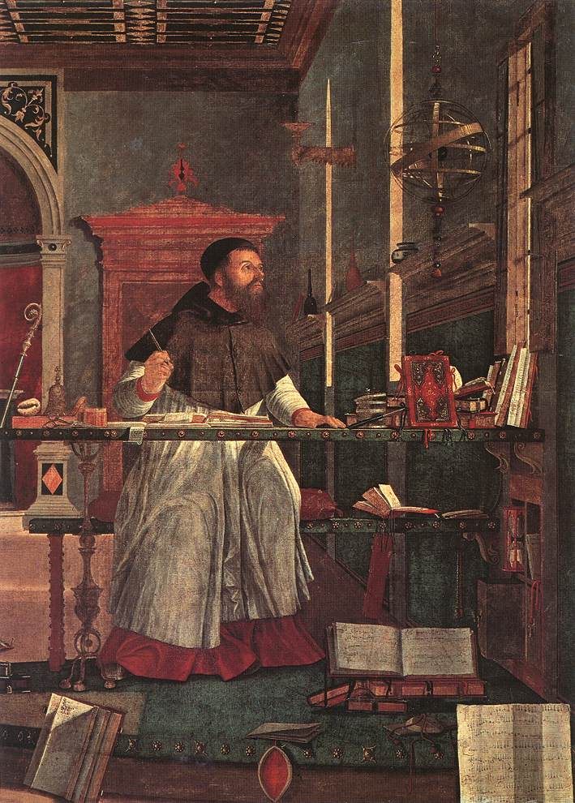
The Happy life and Neo-Platonism
Augustine with the help of philosophy was able to discover that in order to acquire authentic happiness one needed to be wise, for “No one is wise if he is not happy.” (On the Happy Life (386), 2.14.)
“ This, then is the full satisfaction of souls, this is happy life: [2] to recognize piously and completely the One through whom you are led into the truth, [1] the nature of the truth you enjoy, and [3] the bond that connects you with the supreme measure.” (On the Happy Life ,35.)
The knowledge he desires is not simply some theoretical knowledge, but rather he wishes to become what he knows.
A century before Augustine’s time the Platonic philosopher Plotinus summed it up in this remark:
“We act for the sake of some good; this means not for something to remain outside ourselves, not in order that we may possess nothing but that we may hold the good in action. And hold it where? Where in the mind?” (Plotinus, Enneads 3.8.6.)
Picture taken from: http://lifeondoverbeach.files.wordpress.com/2011/08/vittore-carpaccio-st-augustine-in-his-study.jpg

Slide 9
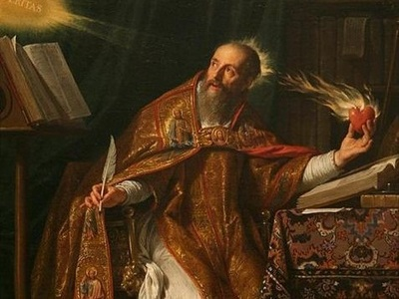
Effects of St. Augustine's works
The institutions and attitudes of the West, both ecclesiastical and political, have formed around Augustine’s interpretation of original sin, sacramental grace, the unruliness of sexuality and the natural world as flawed along with human nature. Roman Catholic theology has been especially influenced by his writings on ecclesiology and the Sacraments.
Western thought has been primarily influenced by Augustine’s grand, essentially biblical, scheme of creation, fall, redemption and ultimate completion and perfection of humanity in the resurrection. Herein lies his importance as a Father of the Church and the Doctor of Grace.
Picture taken from:http://4.bp.blogspot.com/UULaQjaoA4A/URVi91mheUI/AAAAAAAAALQ/HebnfGAjUc8/s1600/Saint_Augustine_by_Philippe_de_Champaigne.jpg

Slide 10
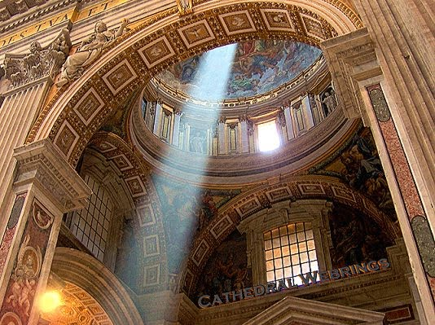
The End
“ How I burned, O my God, how I burned with desire to fly always from earthly things and upwards to You, and yet I did not know what You would do with me! For with You there is wisdom. Love of wisdom has the name philosophy in Greek, and the book [Hortensius] set me on fire for it… At that time… I was stirred up and enkindled and set aflame to love, and pursue, and attain and catch hold of, and strongly embrace no this or that sect, but wisdom itself, whatsoever it might be.” (Conf. 3.4.8)
“ I no longer desired a better world, because I was thinking of creation as a whole: and in the light of this more balanced discernment, I had come to see that higher things are better than lower, but that the sum of all creation is better than the higher things alone.” (Conf. VII, xiii, 19.)

